Slide 1


React + A.I.
Building modern Web components using LLMs

Slide 2
React 101
https://github.com/marcus-yeagle/react-tutorial
https://react.dev/learn/tutorial-tic-tac-toe (source)

Slide 3
React 101
Setup - will give you a starting point to follow the tutorial.
Overview will teach you the fundamentals of React: components, props, and state.
Completing the game - will teach you the most common techniques in React development.
Adding Time Travel - will give you a deeper insight into the unique strengths of React.
Finally - Make A.I. do all the work

Slide 4
React 101
Setup - will give you a starting point to follow the tutorial.
Overview will teach you the fundamentals of React: components, props, and state.
Completing the game - will teach you the most common techniques in React development.
Adding Time Travel - will give you a deeper insight into the unique strengths of React.
Finally - Make A.I. do all the work

Slide 5

Functional Programming (FP)
- Lambda Calculus (Church, Princeton 1930)
- LISP (McCarthy, Caltech 1959)
- Scheme (Sussman/Steele, M.I.T. 1975)
- LiveScript (Eich, NetScape 1995)

Slide 6
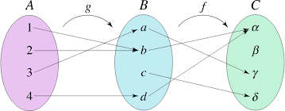
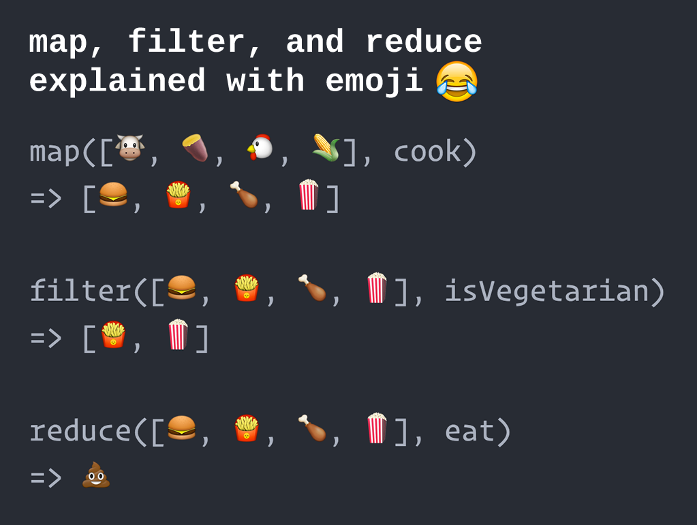
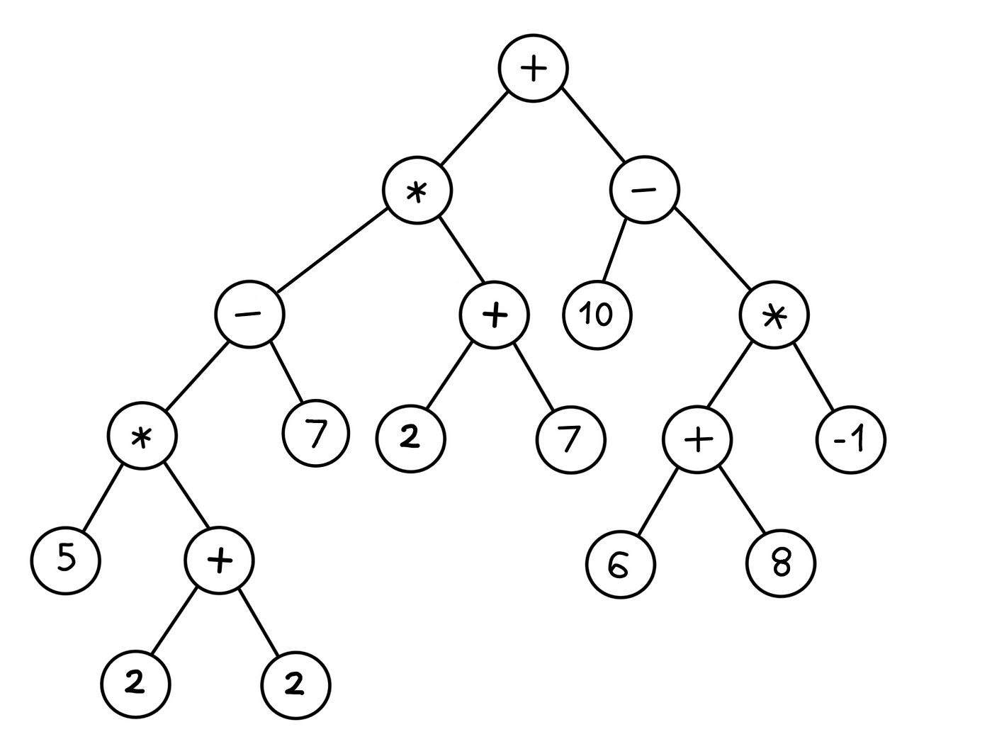
Functional Programming (FP)
- Applying and Composing Functions
- Trees of Expressions
- Map values to values instead of sequence of imperative statements updating the state
- First-class Functions (functions as values)

Slide 7
JavaScript (TS) refresher
Object Literals
{foo: ‘bar’, bin: 42}
Array Literals
[[2, 3, 5], [‘foo’, ‘four’, ‘five’], [1, true, ‘false’]]
Functions Literals
() => { console.log(42) } (anonymous lambda)
((n) => n+1)(3) (IIFE)
function foo() { … } (classical)

Slide 8
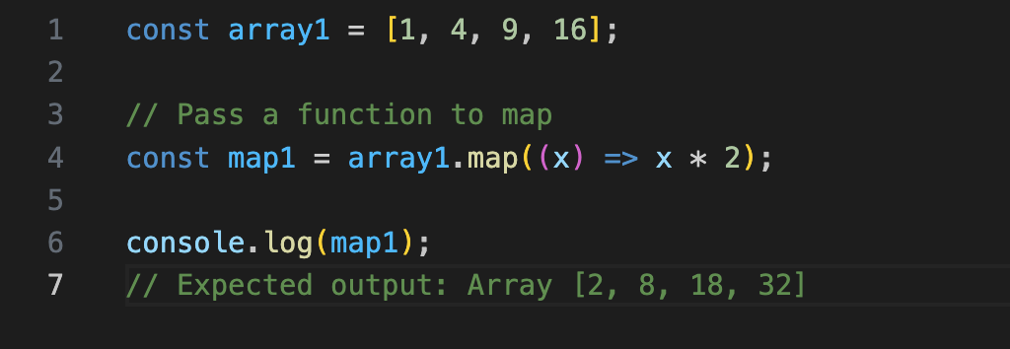
JavaScript (TS) refresher
Map

Slide 9
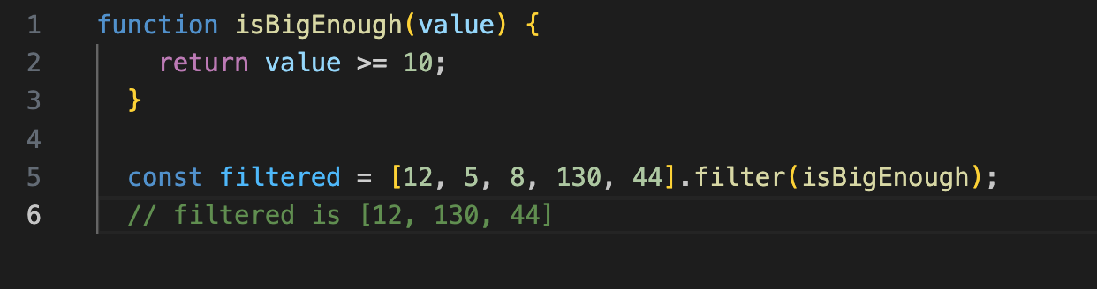
JavaScript (TS) refresher
Filter

Slide 10
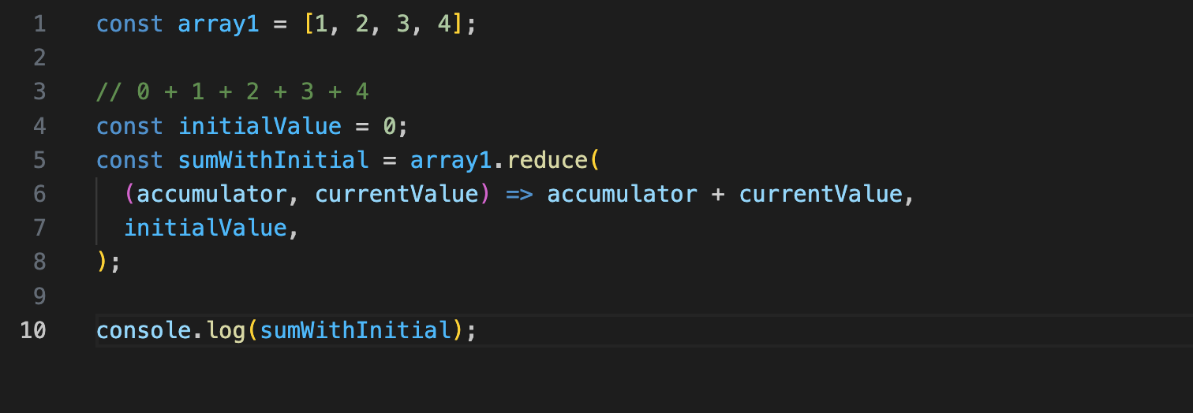
JavaScript (TS) refresher
Reduce

Slide 11
React 101
Setup
Ensure you have installed and setup a proper JS runtime environment with node and npm
Copy the Github source code onto your machine:
https://github.com/marcus-yeagle/react-tutorial

Slide 12
Demo

Slide 13

React 101 - Components
In React, a component is a piece of reusable code that represents a part of a user interface. Components are used to render, manage, and update the UI elements in your application. Let’s look at the component line by line to see what’s going on:
export default function Square() {
return <button className="square">X</button>;
}

Slide 14
React 101 - Components
In React, a component is a piece of reusable code that represents a part of a user interface. Components are used to render, manage, and update the UI elements in your application. Let’s look at the component line by line to see what’s going on:
export default function Square() {
return <button className="square">X</button>;
}

Slide 15

React 101 - Components
export default function Square() {
return (
<>
<button className="square">X</button>
<button className="square">X</button>
</>
);
}

Slide 16
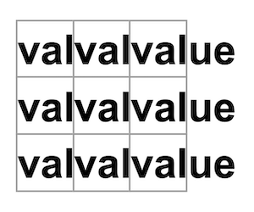
React 101 - Components
function Square({ value }) {
return <button className="square">value</button>;
}

Slide 17
React 101 - Components
function Square({ value }) {
return <button className="square">{value}</button>;
}

Slide 18
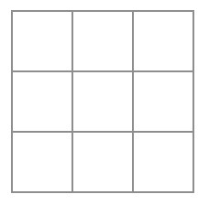
React 101 - Components
function Square({ value }) {
return <button className="square">{value}</button>;
}

Slide 19
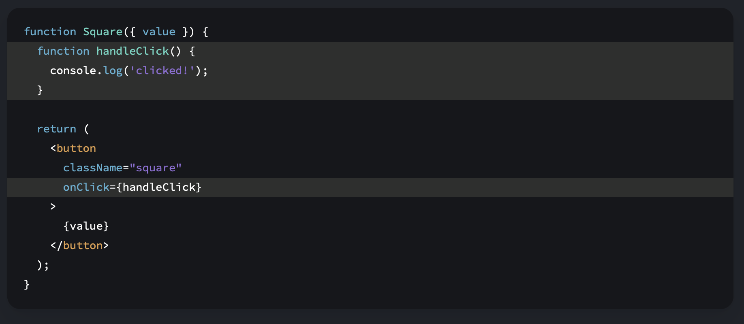
React 101 - Components

Slide 20
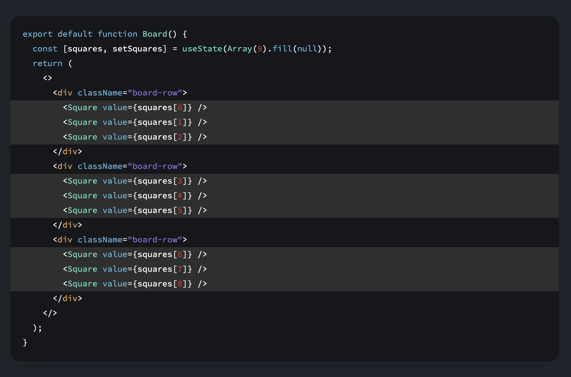
React 101 - Components
['O', null, 'X', 'X', 'X', 'O', 'O', null, null]

Slide 21
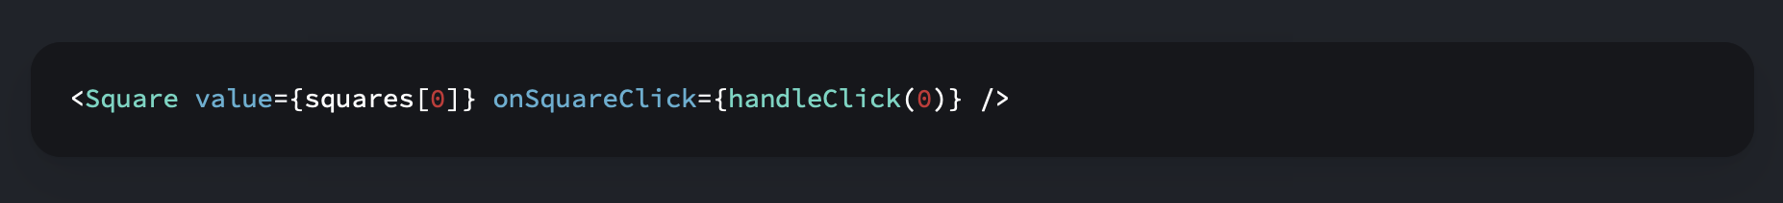
React 101 - Components

Slide 22
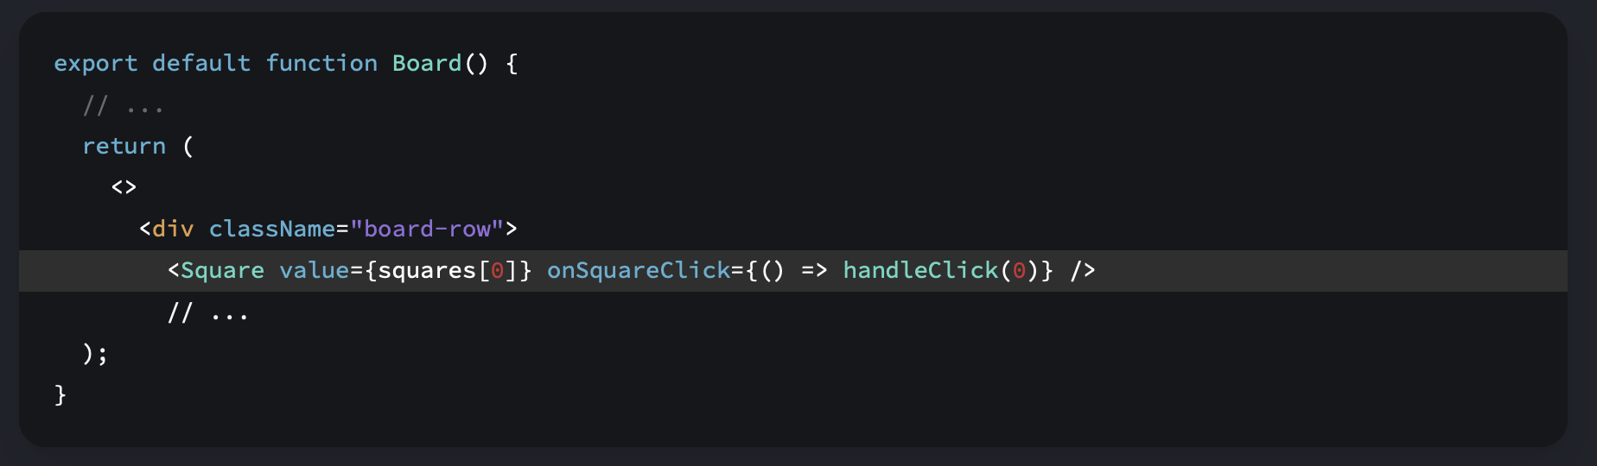
React 101 - Components

Slide 23
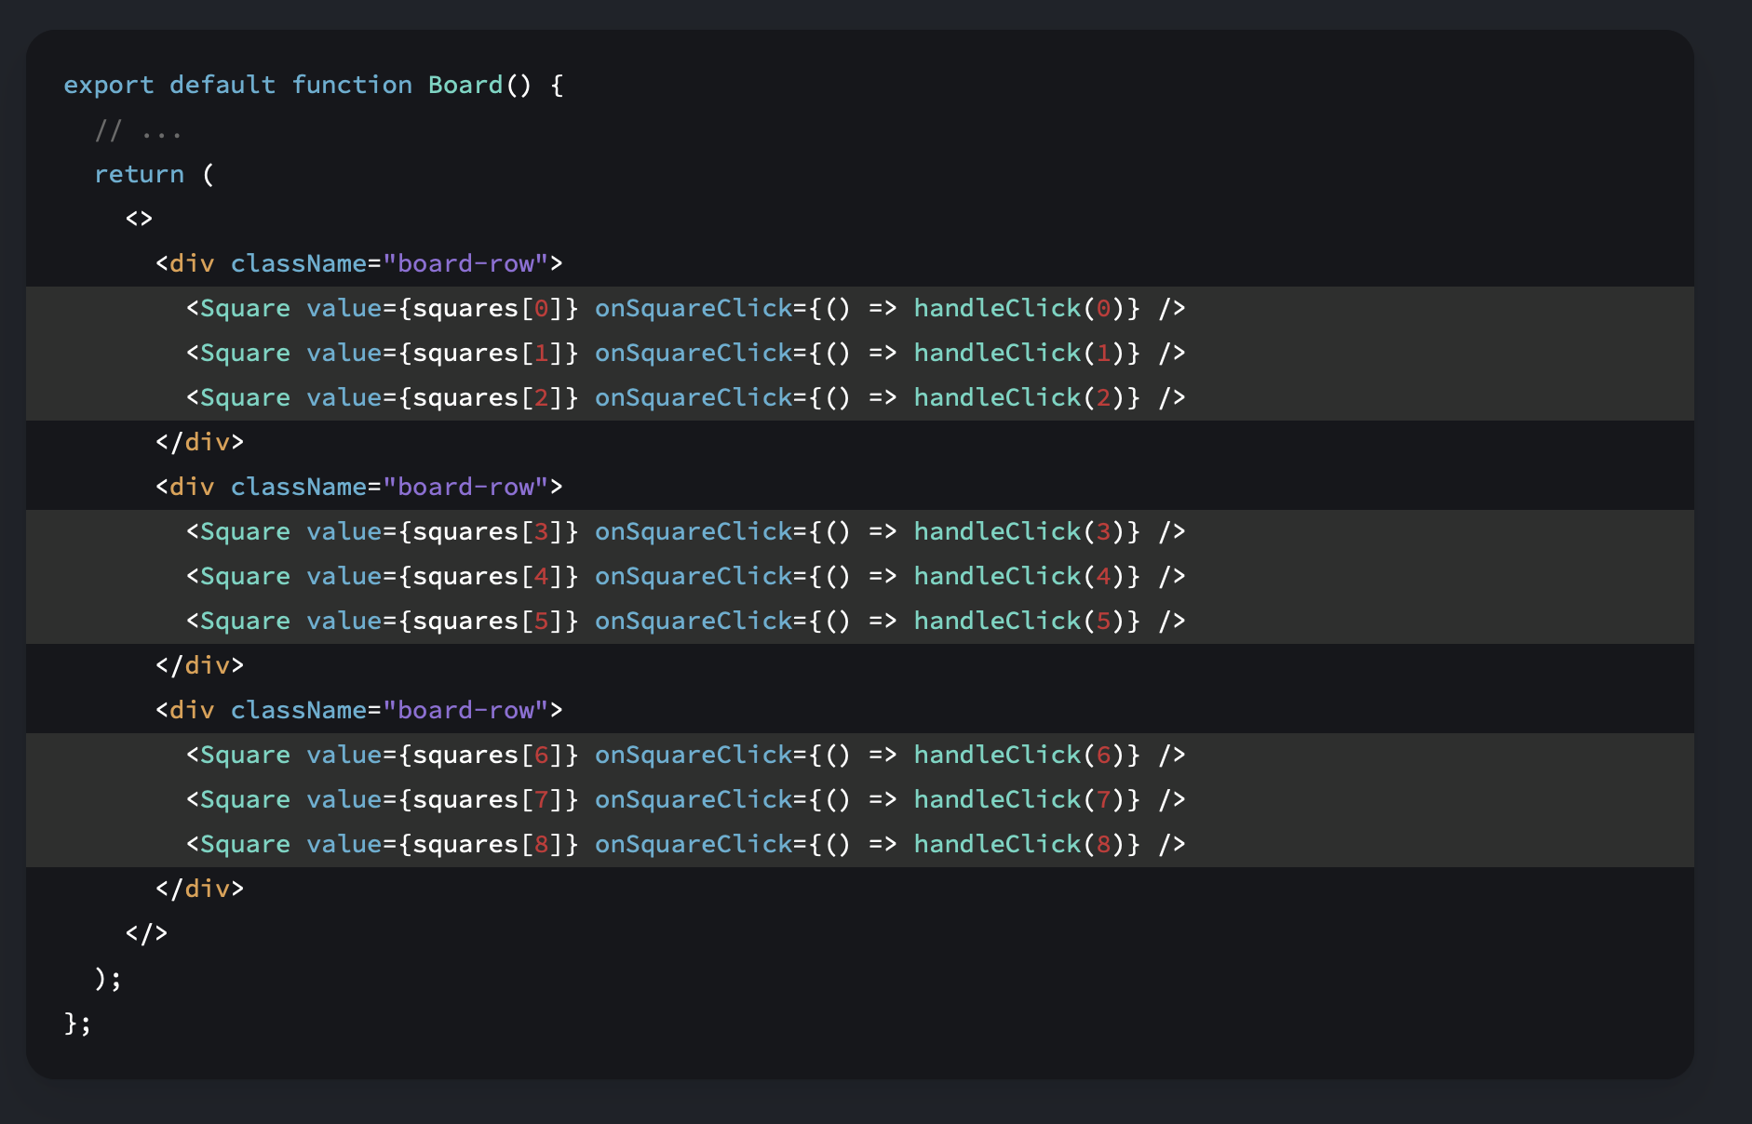
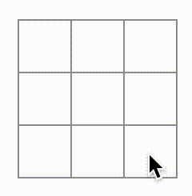
React 101 - Components
[null, null, null, null, null, null, null, null, ‘X’]

Slide 24
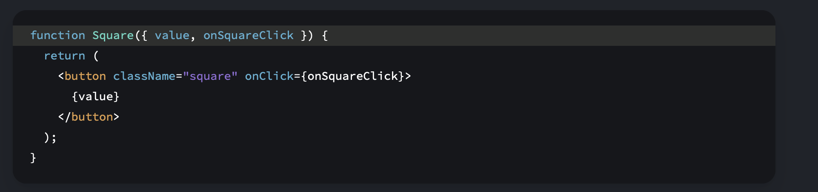
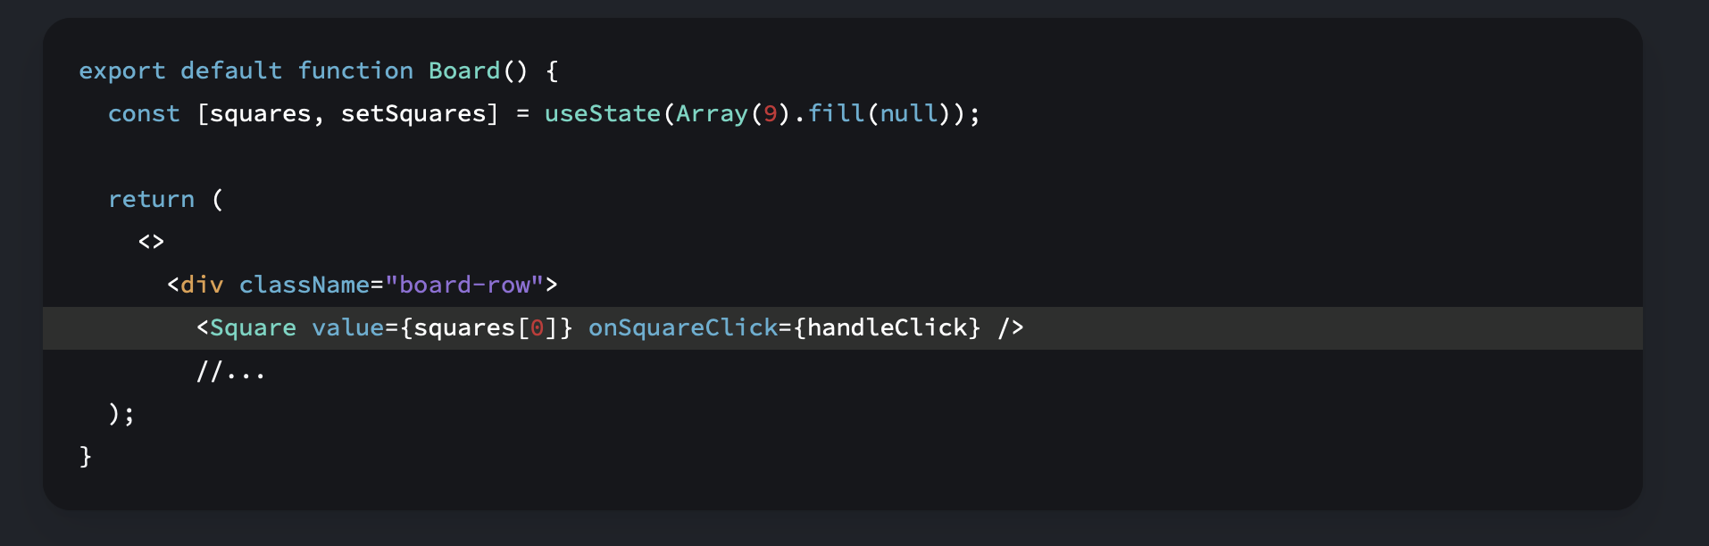
React 101 - Components

Slide 25
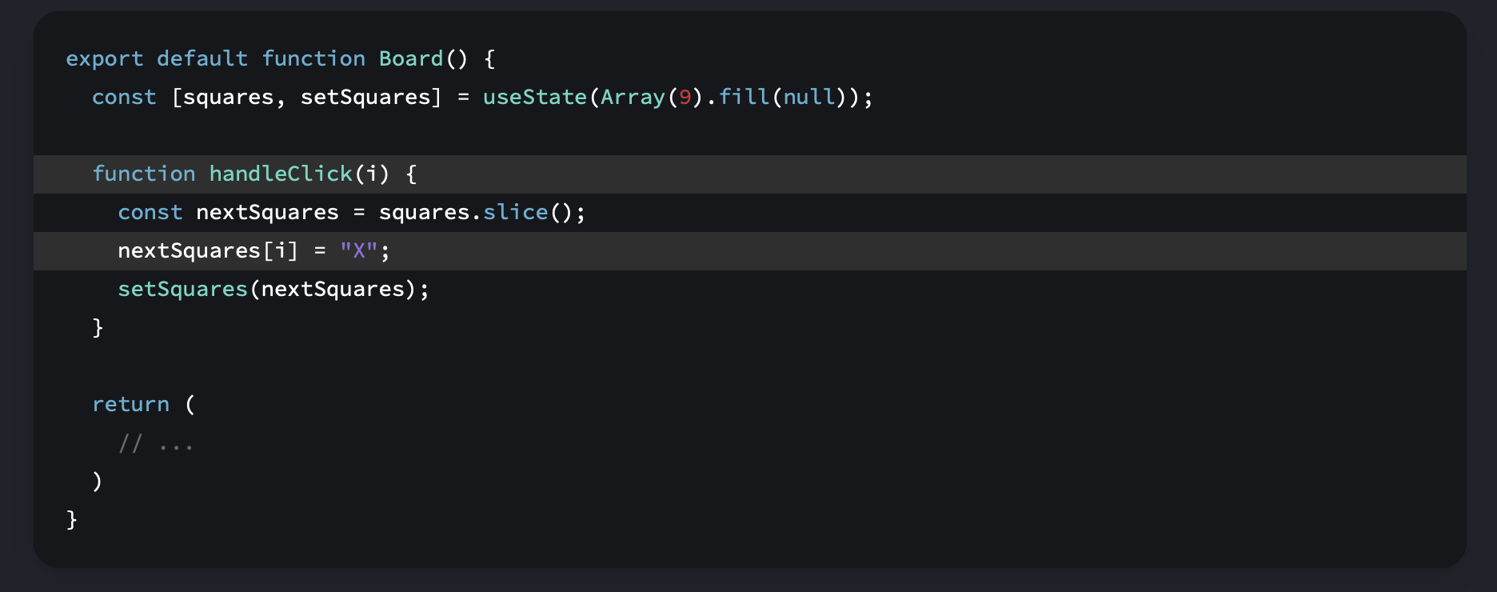
React 101 – Component State
The handleClick function creates a copy of the squares array (nextSquares) with the JavaScript slice() Array method. Then, handleClick updates the nextSquares array to add X to the first ([0] index) square.
Calling the setSquares function lets React know the state of the component has changed. This will trigger a re-render of the components that use the squares state (Board) as well as its child components (the Square components that make up the board).
[null, null, null, null, null, null, null, null, null]
[null, null, null, null, null, null, null, null, ‘X’]

Slide 26
React 101 – Component State
- Now that your state handling is in the Board component, the parent Board component passes props to the child Square components so that they can be displayed correctly.
B
S1
S2
S2
...
B
S1
S2

Slide 27
React 101 – Component State
- Now that your state handling is in the Board component, the parent Board component passes props to the child Square components so that they can be displayed correctly.
- When clicking on a Square, the child Square component now asks the parent Board component to update the state of the board.
B
S1
S2
...
B
S1
S2

Slide 28
React 101 – Component State
- Now that your state handling is in the Board component, the parent Board component passes props to the child Square components so that they can be displayed correctly.
- When clicking on a Square, the child Square component now asks the parent Board component to update the state of the board.
- When the Board’s state changes, both the Board component and every child Square re-renders automatically.
- Keeping the state of all squares in the Board component will allow it to determine the winner in the future.
B
S1
S2
...
B
S1
S2

Slide 29
React 101 – Immutability
There are generally two approaches to changing data.
The first approach is to mutate the data by directly changing the data’s values.
const squares = [null, null, null, null, null, null … ];
squares[0] = ‘X’;
The second approach is to replace the data with a new copy which has the desired changes. Here is what it would look like if you mutated the squares array:
const squares = [null, null, null, null, null, null … ];
const nextSquares = [‘X’, null, null, null, null, null … ];
There is also another benefit of immutability: By default, all child components re-render automatically when the state of a parent component changes.
Immutability makes it very cheap for components to compare whether their data has changed or not.

Slide 30
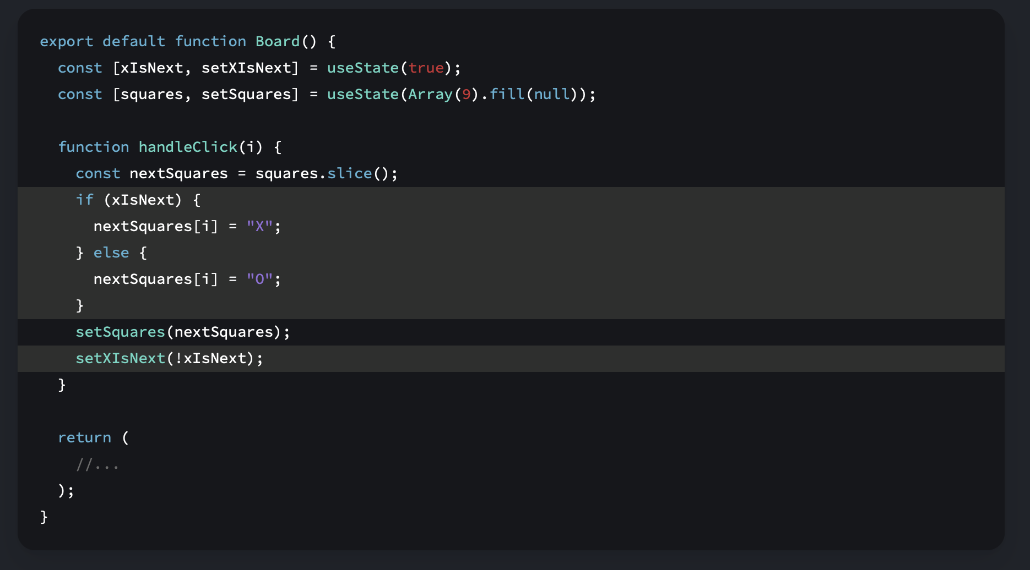
React 101 – Component Logic

Slide 31
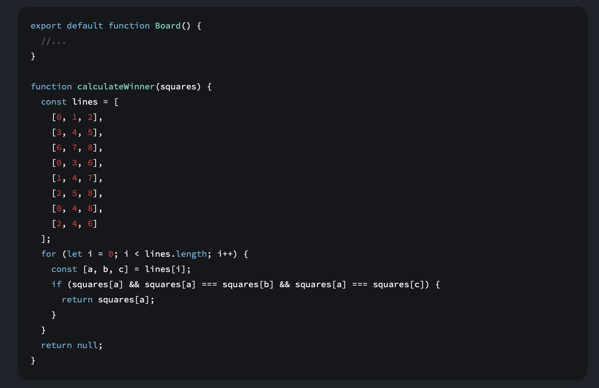
React 101 – Component Logic

Slide 32
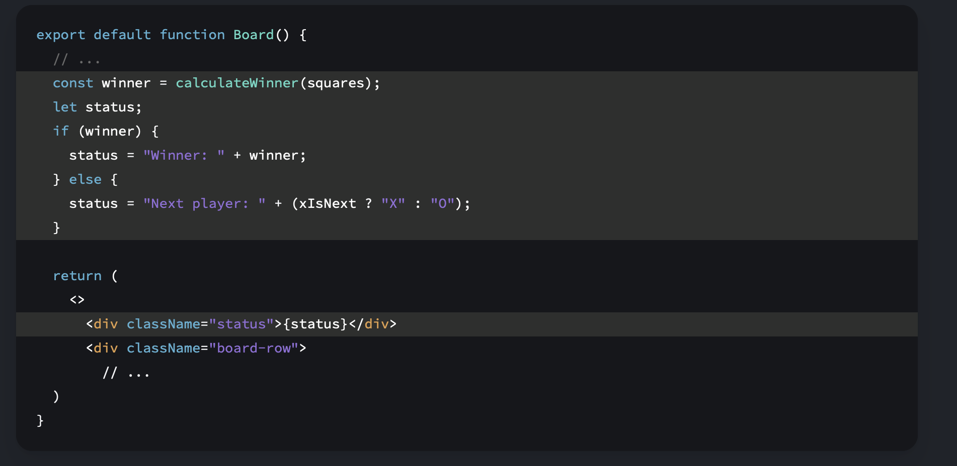
React 101 – Component Logic

Slide 33
A.I. Development – GPT

Slide 34


Further Learning – Resources
Books
- Structure and Interpretation of Computer Programs (SICP)
- Paradigms of Artificial Intelligence Programming: Case studies in Common Lisp
(PAIP)
Videos
- Learning Functional Programming with JavaScript - Anjana Vakil - JSUnconf
- A Flock of Functions: Lambda Calculus and Combinatory Logic in JavaScript | Gabriel Lebec @ DevTalks

